Slide 1
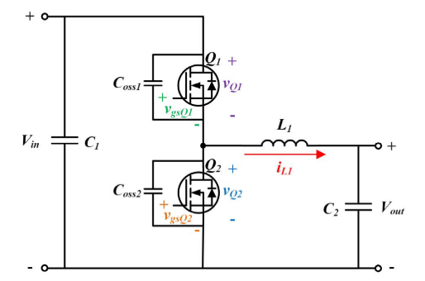
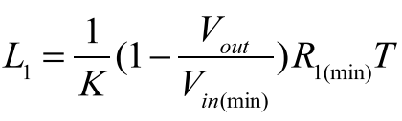

Synchronous Buck Converter with Zero-Voltage Resonant-Transition Switching
Simple Soft Switching
Additional passive and active components or a complicated loop control is not required
High conduction current due to high current ripple
Required condition for soft-switching:
Synchronous buck converter
K is proportional to input voltage
K is inv. prop. to maximum output current
The ratio between the peak-to-peak inductor current ripple and the average inductor current
Output load resitance
$$K∗t_{turn−off}=t_{turn−on}+t_{turn−off}$$
$$K=2 →t_{turn−on}=t_{turn−off}$$

Slide 2
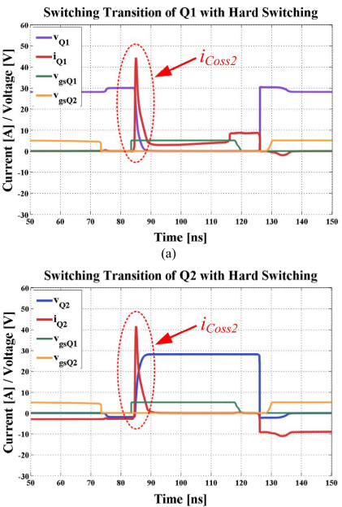
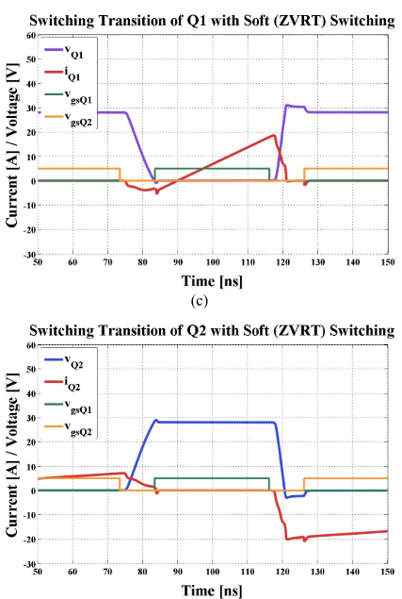
Spike on the switching current is removed
Unfortunately, the switching losses are still non-zero

Slide 3



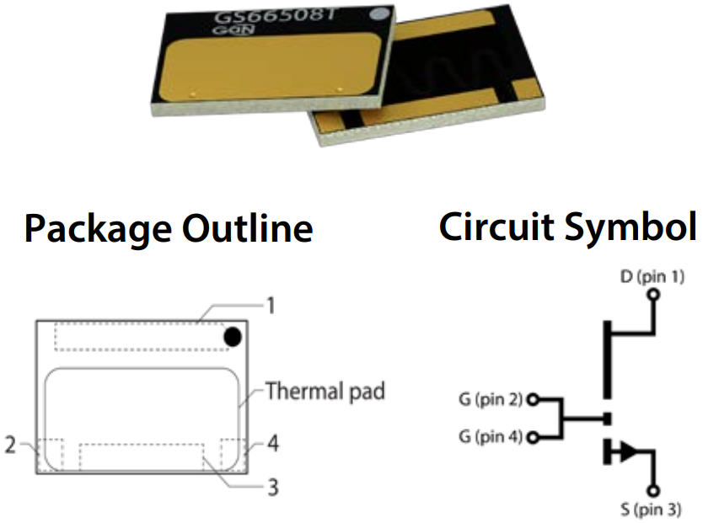
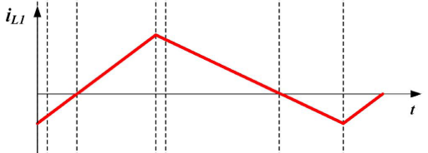
Loss Calculation
Transistor Parameters
GS66508T
650V / 30A
Top Cooling
Rds-on (150˚C) -> 129 mΩ
Coss -> 88 pF
DC
AC
Average Transition Time
Inductor Current

Slide 4
Loss Analysis
Vin = 540V
Vout = 400V
Iout = 20A
Pout = 8 kW
K = 4
Rise Time = 10 nsec
4 Parallel Transistor
3 Parallel Transistor

Slide 5
Loss Analysis
Vin = 540V
Vout = 400V
Iout = 10A
Pout = 4 kW
K = 4
Rise Time = 10 nsec
4 Parallel Transistor
2 Parallel Transistor

Slide 6
Loss Analysis
Vin = 220V
Vout = 150V
Iout = 20A
Pout = 3 kW
K = 4
Rise Time = 10 nsec
4 Parallel Transistor
3 Parallel Transistor

Slide 7
Loss Analysis
Vin = 220V
Vout = 150V
Iout = 10A
Pout = 1.5 kW
K = 4
Rise Time = 10 nsec
4 Parallel Transistor
3 Parallel Transistor

Slide 8
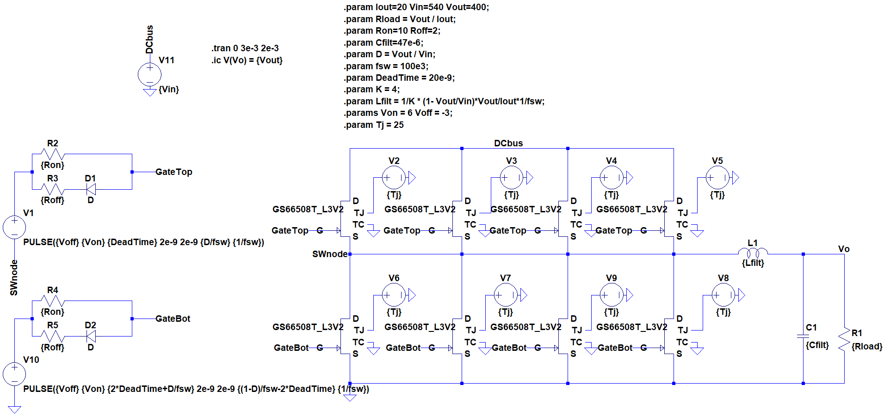
Simulation Study

Slide 9
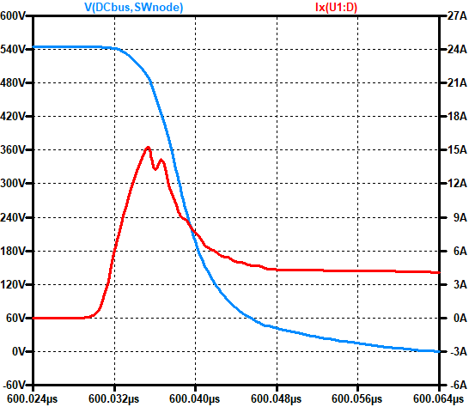
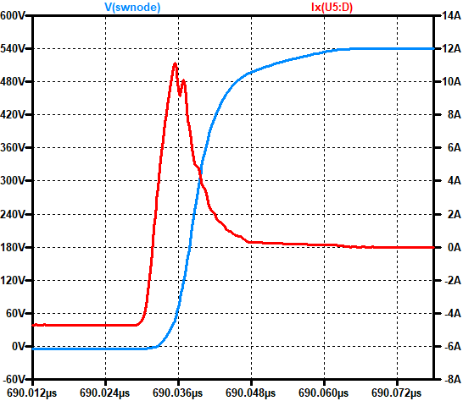
K = 0.25 -> Hard-switching Vin = 540V
Vout = 400V, Pout = 8 kW
fsw = 100 kHz, Tj = 25˚C
Simulation Study
4 App Ripple
Top Switch
Bottom Switch
Power Loss 7.1296 W
Power Loss 0.432 W
Total Transistor Loss = 30.2464 W

Slide 10
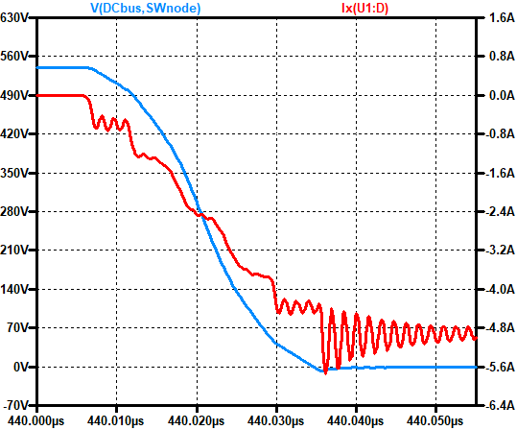
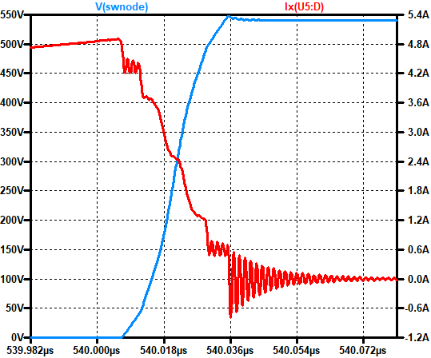
K = 4 -> Soft-switching Vin = 540V
Vout = 400V, Pout = 8 kW
fsw = 100 kHz, Tj = 25˚C
Simulation Study
80 App Ripple
Top Switch
Bottom Switch
Power Loss 2.2542 W
Power Loss 0.979 W
Total Transistor Loss = 12.9328 W
%57

Slide 11
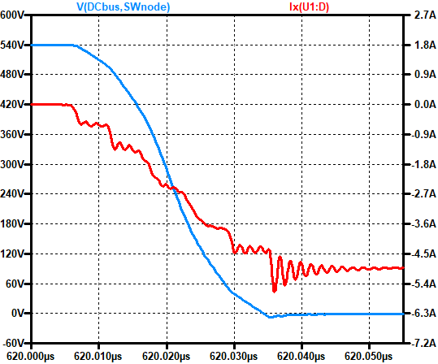
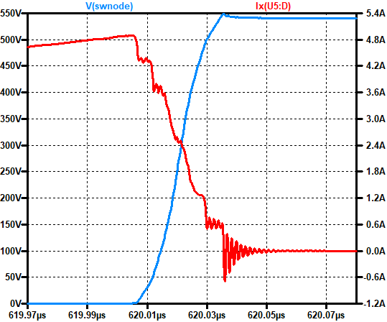
K = 4 -> Soft-switching Vin = 540V
Vout = 400V, Pout = 8 kW
fsw = 100 kHz, Tj = 125˚C
Simulation Study
80 App Ripple
Top Switch
Bottom Switch
Power Loss 5.3075 W
Power Loss 2.1791 W
Total Transistor Loss = 29.9464 W
%37

Slide 12
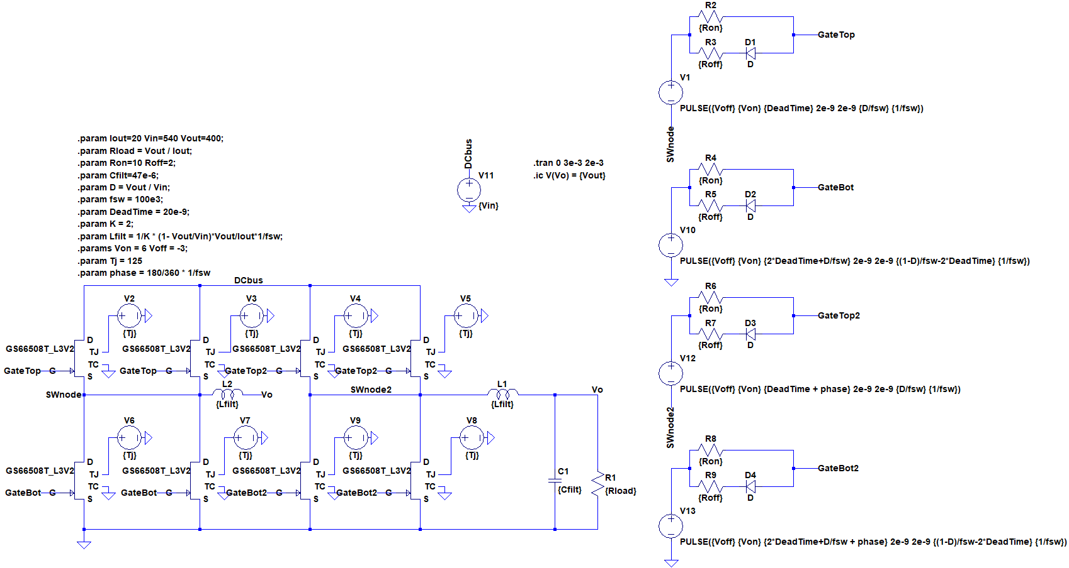
Simulation Study
Seperated Switching Nodes for Interleaving

Slide 13


Simulation Study
Advantages of Interleaved Half-Bridges for ZVRT Switching Buck Converter Application
The average output current is shared between two inductors which reduces average inductor current
Having less average inductor current requires less ripple current (K *Iavg)
Applying 180˚ phase shift between two half-bridges reduces stress over output capacitor significantly
What we get from interleaving
$$I_{L_{avg}}=20 A →I_{L_{avg}}^{∗}=10 A$$
$$I_{L_{pp}}=80 App →I_{L_{pp}}^{∗}=40 App$$
$$I_{C_{pp}}=80 App @ 100 kHz →I_{C_{pp}}^{∗}=26 App @ 200 kHz$$

Slide 14
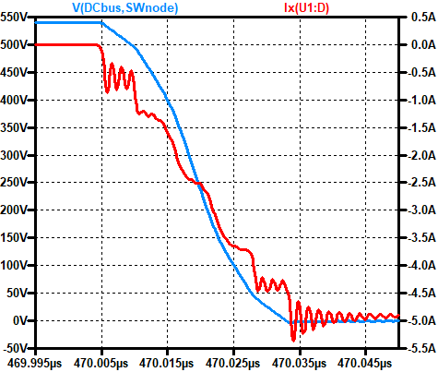
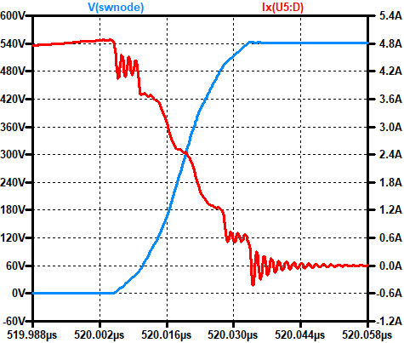
K = 4 -> Soft-switching Vin = 540V
Vout = 400V, Pout = 8 kW
fsw = 100 kHz, Tj = 125˚C
With Interleaving
Simulation Study
26 App Ripple @ 200 kHz
Top Switch
Bottom Switch
Power Loss 5.2144 W
Power Loss 2.0775 W
Total Transistor Loss = 29.1676 W
%15

Slide 15
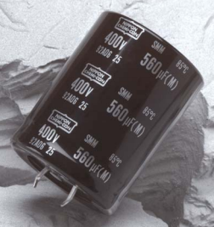
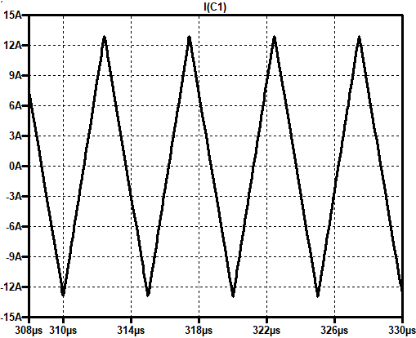
Simulation Study – Filter Design
Capacitor Current
ESMM451VSN331MQ50S
Digikey Link – 4.98$
Capacitance: 330 μF
Rated Voltage: 450V
Rated Current: 3A @ 100kHz
ESR: 1.005ohm @120Hz
7.5 Arms @200kHz
Three of this capacitor are required!

Slide 16
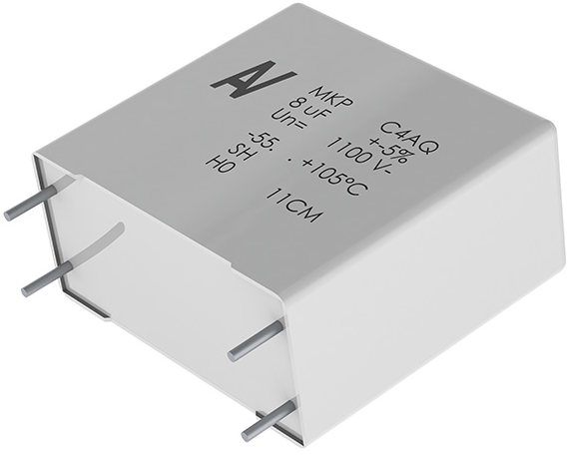
Simulation Study – Filter Design
Capacitor Current
C4AQCBW5200A3FJ
Digikey Link – 4.82$
Capacitance: 20 μF
Rated Voltage: 650V
Rated Current: 11A @ 10kHz
ESR: 5.3 mOhm @10kHz
7.5 Arms @200kHz
Only one of this capacitor is required!

Slide 17
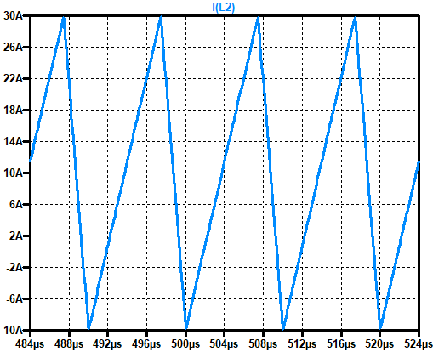
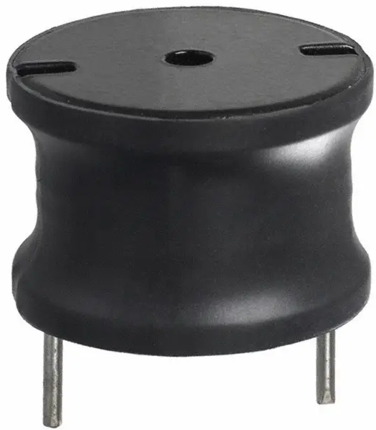
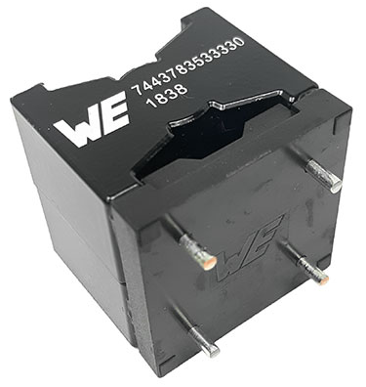
Simulation Study – Filter Design
Inductor Current
Option #1
Option #2
1140-330K-RC
7443783533330
Digikey Link – 9.56$
Digikey Link – 14.02$
Inductance: 33 μH @1KHz
Rated Current: 15.8 A
Sat. Current: 36.5 A
DCR: 11 mOhm
Inductance: 33 μH @100KHz
Rated Current: 22 A
Sat. Current: 39.2 A
DCR: 9.9 mOhm
26 μH
15 Arms @100kHz
10 Adc
30A, -10A peak points
Self-Resonance?
Can cause hard-switching
Two of this inductor are required!

Slide 18
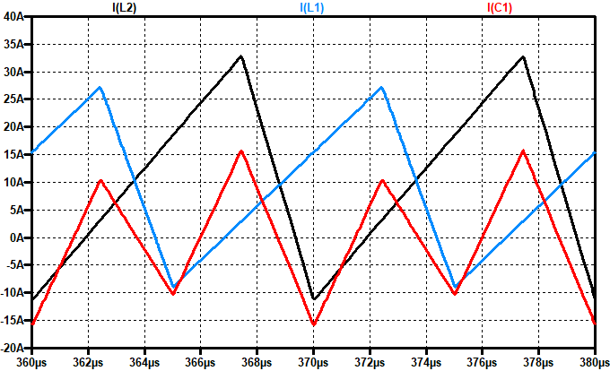
Simulation Study – Filter Design
Inductance Tolerances (+/-10%)
Balanced Ind.
Unbalanced Ind.
L1 Ratings
13.9 Arms @100kHz
9.2 Adc
27.1A, -8.8A peak points
L Ratings
15 Arms @100kHz
10 Adc
30A, -10A peak points
L2 Ratings
16.75 Arms @100kHz
10.8 Adc
32.7A, -10.6A peak points
C Ratings
7.5 Arms @200kHz
C Ratings
7.9 Arms @200kHz
Unbalanced conditions
don’t seem that harmful!

Slide 19
Simulation Study with Selected Filters
 | Results before filter selections | Results after filter selections
I(C) | 26 App @200 kHz | 20 App @200 kHz
I(L) | 15 Arms | 13.5 Arms
Ipeak(L) | 30 A, -10 A | 25.6 A, -5.6 A
Ploss(top switch) | 5.2144 W | 4.805 W
Ploss(bot switch) | 2.0775 W | 1.9416 W
Ploss(total) | 29.17 W | 27 W
Vout,pp | 0.8 V | 0.4 V
The main change is filter inductance. It is changed from 26 μH to 33 μH!

Slide 20
Simulation Study with Different Switching Frequencies
 | Results for 100 kHz | Results for 300 kHz
I(C) | 26 App @200 kHz | 26 App @600 kHz
I(L) | 15 Arms @100 kHz | 15 Arms @300 kHz
Ipeak(L) | 30 A, -10 A | 30 A, -10 A
Ploss(top switch) | 4.805 W | 6.05 W
Ploss(bot switch) | 1.9416 W | 3.04 W
Ploss(total) | 27 W | 36.4 W
Vout,pp | 0.4 V | 0.8 V
The main gain is volume.
Inductance and capacitance requirements are now one-third!
What about the heatsink?

Slide 21
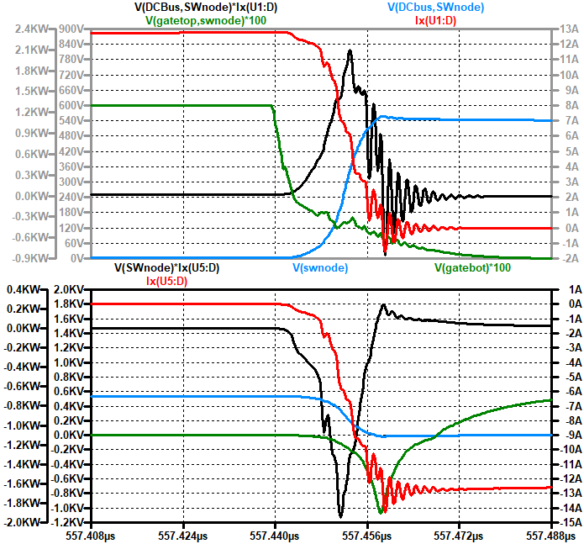
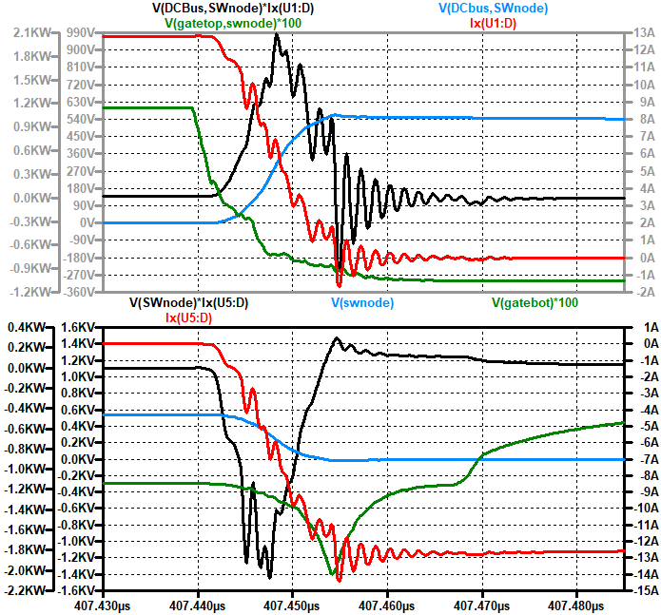
Simulation Study with Different Negative Gate Drive Levels
Vgs (0V)
Top Transistor
Vgs (-3V)
5.12 W
4.805 W

Slide 22
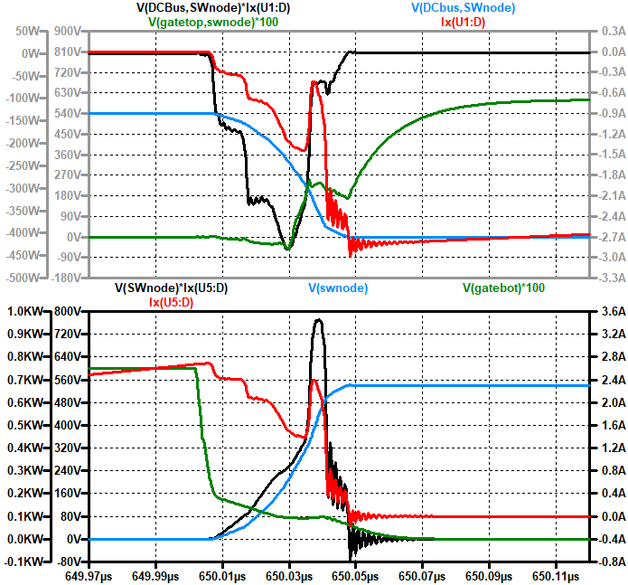
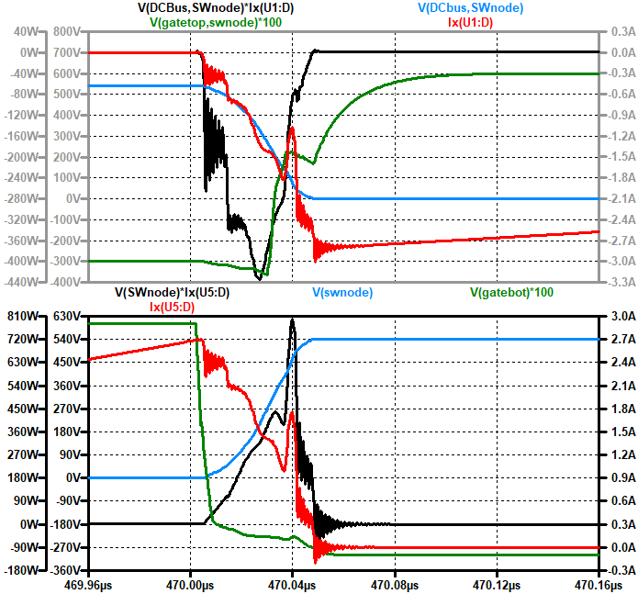
Simulation Study with Different Negative Gate Drive Levels
Vgs (0V)
Bot Transistor
Vgs (-3V)
1.85 W
1.94 W

Slide 23
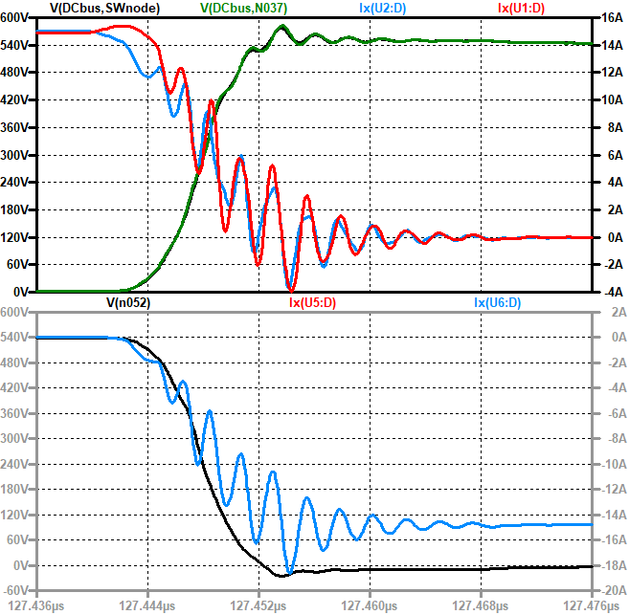
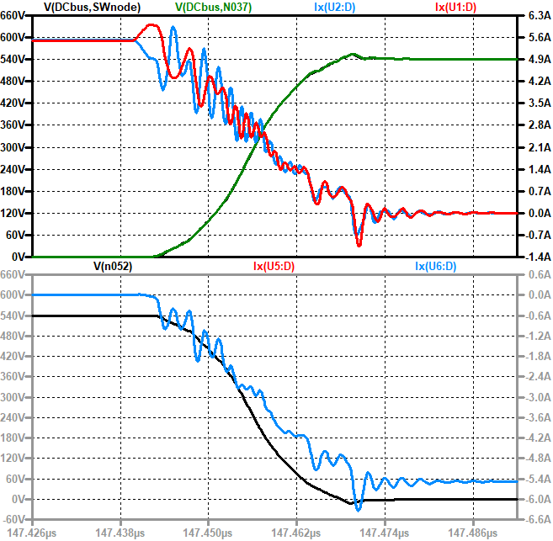
Simulation Study with Parasitics
Soft-switching
Turn-off Event
Hard-switching
There is 1 nH CSI difference for top switch

Slide 24
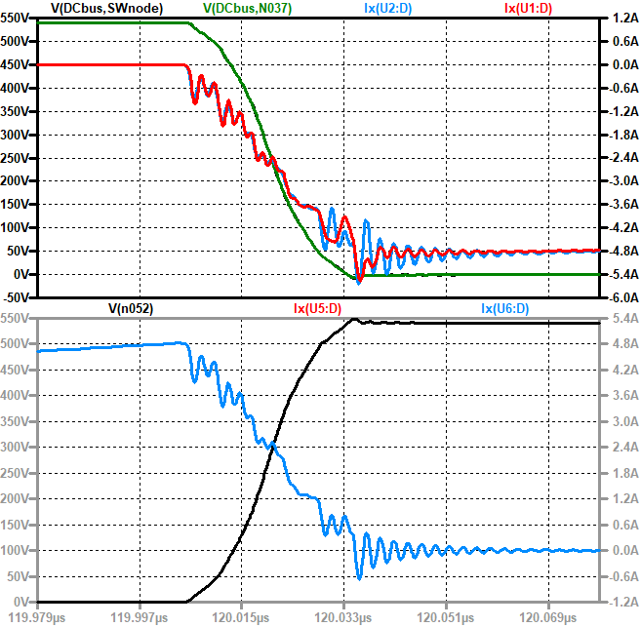
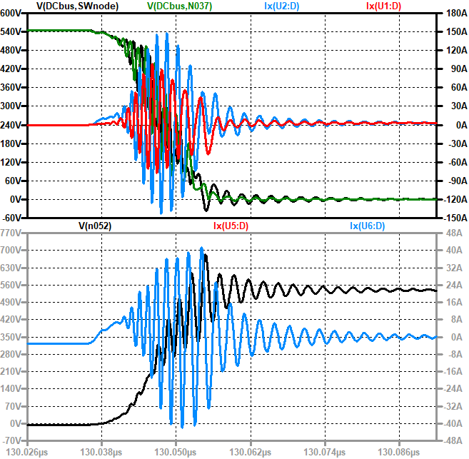
Simulation Study with Parasitics
Soft-switching
Turn-on Event
Hard-switching
There is 1 nH CSI difference for top switch

